Slide 1
Chapter 16

Slide 2
Objectives

Slide 3
Objectives (cont.)

Slide 4
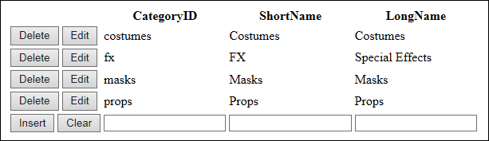
A ListView control that provides for updating a table

Slide 5
Basic properties of the ListView control

Slide 6
Template elements used by the ListView control

Slide 7
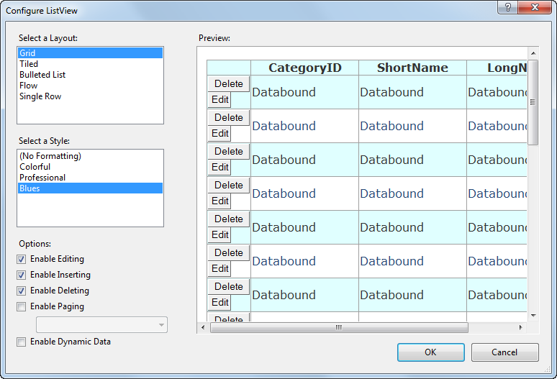
The Configure ListView dialog box

Slide 8
The Layout template for the Categories ListView control

Slide 9
The Item template for the ListView control

Slide 10
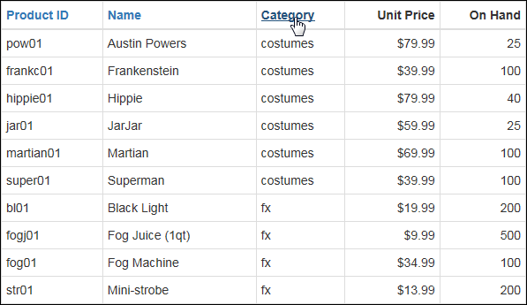
A ListView control that provides for sorting

Slide 11
The Layout template for the ListView control

Slide 12
The Layout template for the ListView control (cont.)

Slide 13
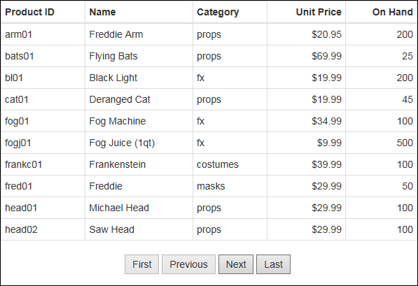
A ListView control that uses a next/previous pager

Slide 14
The aspx code for the next/previous pager

Slide 15
A numeric pager

Slide 16
Properties of the DataPager control

Slide 17
The aspx code for a DataPager control that uses both types of pagers

Slide 18
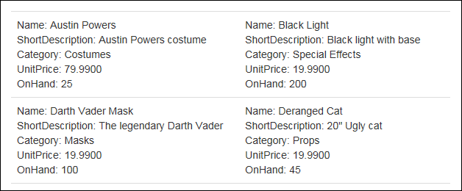
The beginning of a ListView control with two columns

Slide 19
The Layout and Group templates for the control

Slide 20
The Layout and Group templates for the control (cont.)

Slide 21
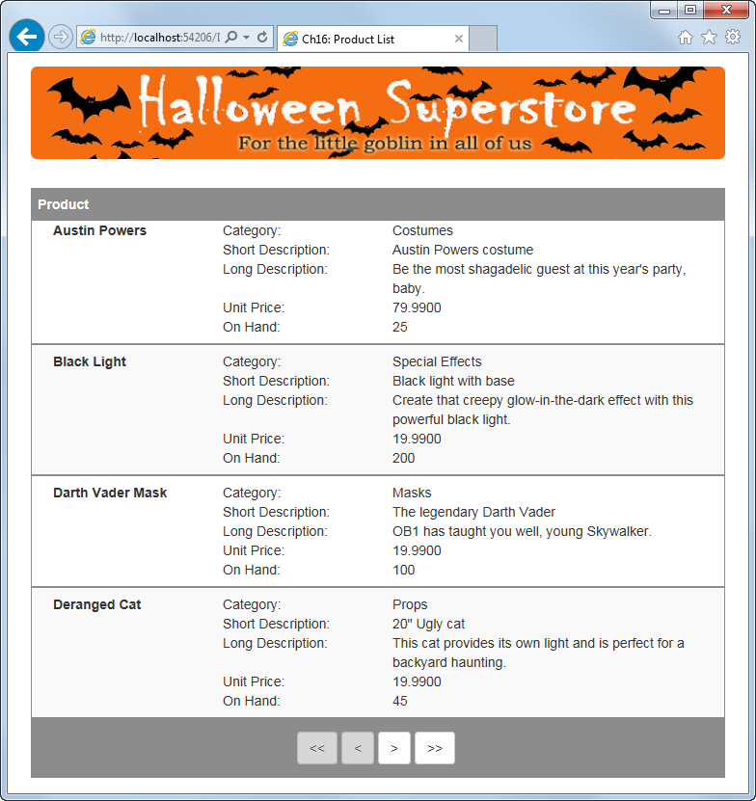
The Product List application

Slide 22
The Default.aspx file

Slide 23
The Default.aspx file (cont.)

Slide 24
The Default.aspx file (cont.)

Slide 25
The Default.aspx file (cont.)

Slide 26
The Default.aspx file (cont.)

Slide 27
The Default.aspx file (cont.)

Slide 28
The Default.aspx file (cont.)

Slide 29
Buttons for working with the data in a ListView control

Slide 30
The aspx code for the Edit and Delete buttons in an Item template

Slide 31
The EditItem template for the Categories ListView control

Slide 32
The InsertItem template for the Categories ListView control

Slide 33
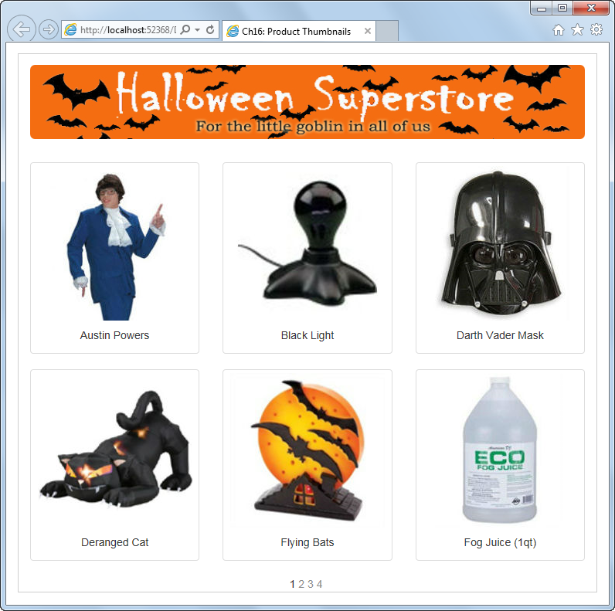
Extra 16-1 Create a Product List application

Slide 34
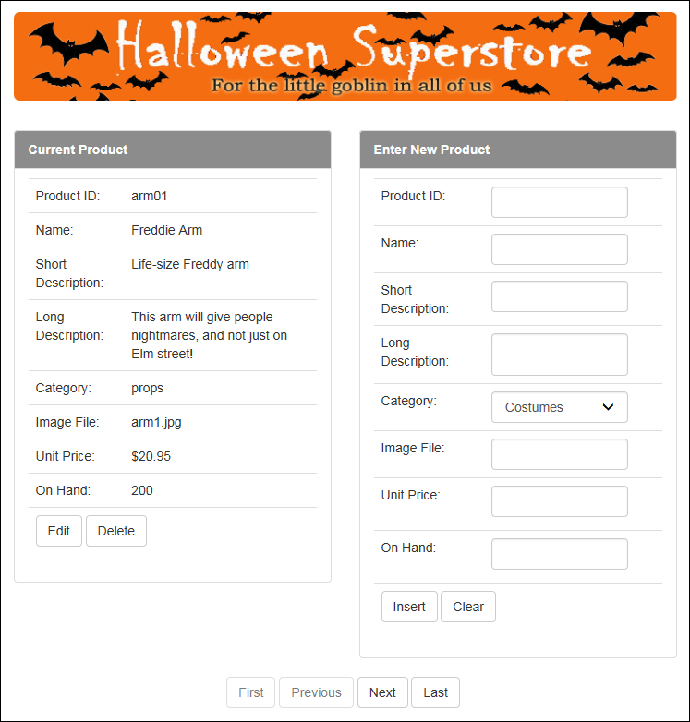
Extra 16-2 Create a Product Maintenance application

